Slide 1
Hidden Page
Teacher may follow the instructions below the pages to make the class effective.
Notes:
This slide is not for the students but for the teachers.

Slide 2

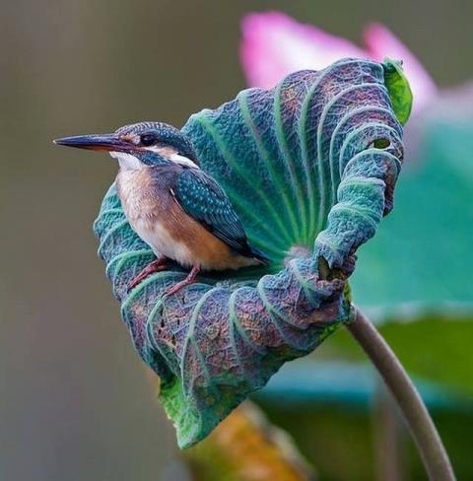
.
Notes:
No need to click.

Slide 3
Introduction
Md Hasan Hafizur Rahman
Senior Lecturer Department of English Campus-5 Cambrian School & College, Dhaka | Class-8 English First Paper
Notes:
Introduction of teacher & class.

Slide 4
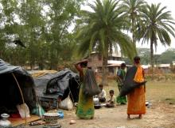
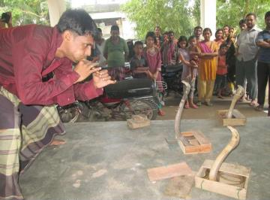
Gypsy
Notes:
Teacher may click accordingly to conduct this page.

Slide 5
Our Today’s Lesson is-
River Gypsies in Bangladesh
Unit-7, Lesson-3
Notes:
Lesson declaration

Slide 6
Learning outcomes
After we have studied this lesson. we will be able to---
ask and answer questions
read and understand the text
participate them in a short paragraph
Notes:
This will cover both speaking, listening, reading & writing skills.

Slide 7
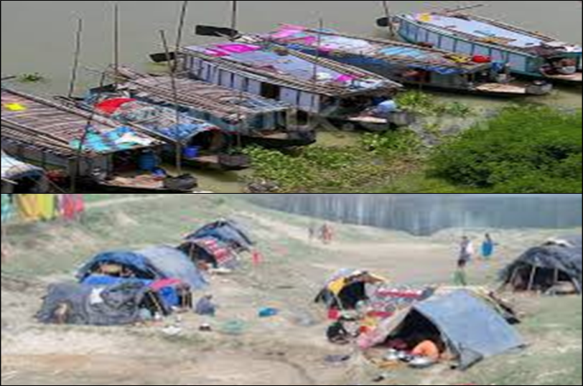
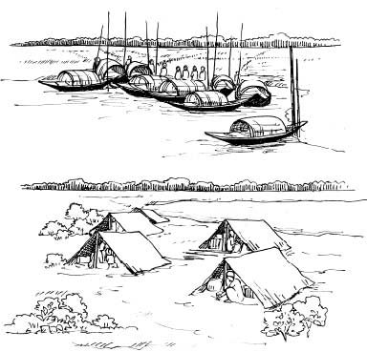

A Look at the pictures and discuss with your partner what you see.
Notes:
Teacher may ask the students to talk about the pictures with their partners. To go to text directly click right arrow.

Slide 8
Hidden page
If time may cover, teacher may show this option. If not, he may avoid this option. Teacher may show the word first and ask meaning. Then he may go ahead according to need.
Notes:
Not for the students

Slide 9
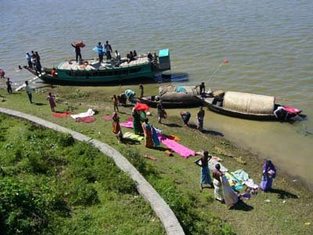
Gypsies
Meaning : Nomads, travelers
The gypsies are in the habit of nomadic life.
Notes:
Teacher may show the word first, then ask the meaning, then he can show the details accordingly.

Slide 10
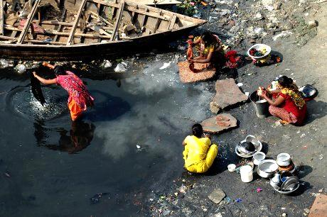
Lifestyle
Meaning : existence/way of life
How inhuman lifestyle they lead!
Notes:
Teacher may show the word first, then ask the meaning, then he can show the details accordingly.

Slide 11
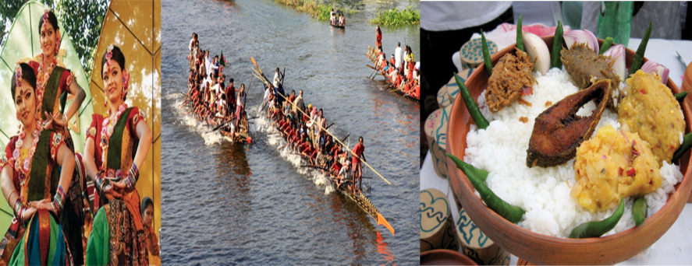
Culture
Meaning : Arts/beliefs
We have our own culture.
Notes:
Teacher may show the word first, then ask the meaning, then he can show the details accordingly.

Slide 12
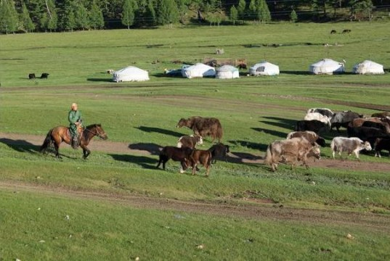
Nomadic
Meaning : temporary/vagabond like
Nomadic life is indeed very difficult.
Notes:
Teacher may show the word first, then ask the meaning, then he can show the details accordingly.

Slide 13
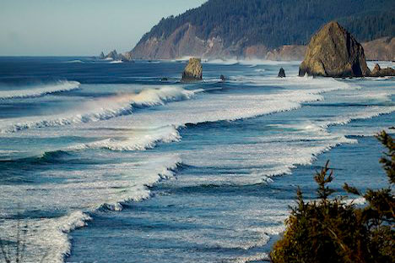
Waters
Meaning : sea / ocean
There are seven waters in the world.
Notes:
Teacher may show the word first, then ask the meaning, then he can show the details accordingly.

Slide 14
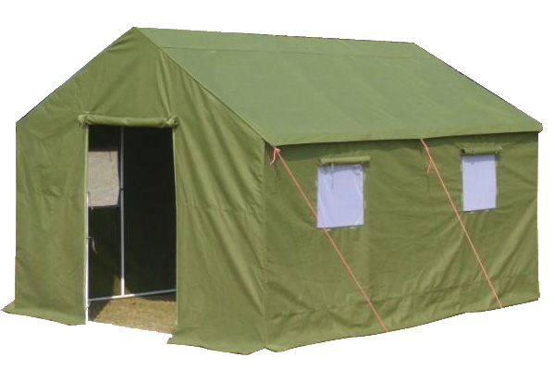
Tarpaulin
Meaning : Canvas / thick cover
This is a tarpaulin made tent.
Notes:
Teacher may show the word first, then ask the meaning, then he can show the details accordingly.

Slide 15
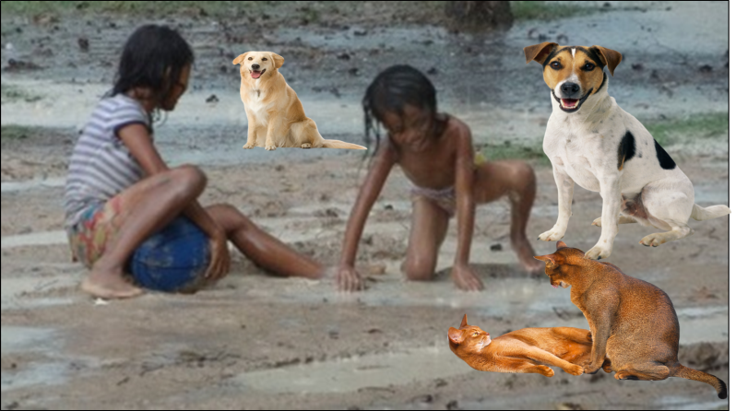

Toddlers
Infant, minor, baby, kid
Toddlers play with dogs or other pets in the dust.
Notes:
Teacher may show the word first, then ask the meaning, then he can show the details accordingly. Please don’t click on right arrow just here.

Slide 16
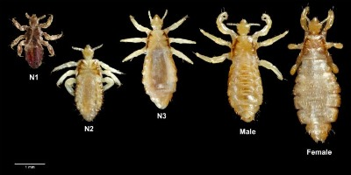
lice
Meaning : Parasites/fleas
Village women pick up lice sitting in a row.
Notes:
Teacher may show the word first, then ask the meaning, then he can show the details accordingly.

Slide 17
Hidden page
Silent reading
Teacher may ask the students to read this option silently. He may monitor.
Notes:
Teacher may ask the students to open their text books to read this option (River gypsies are an ethnic group ------ threes sitting in a row) silently.

Slide 18
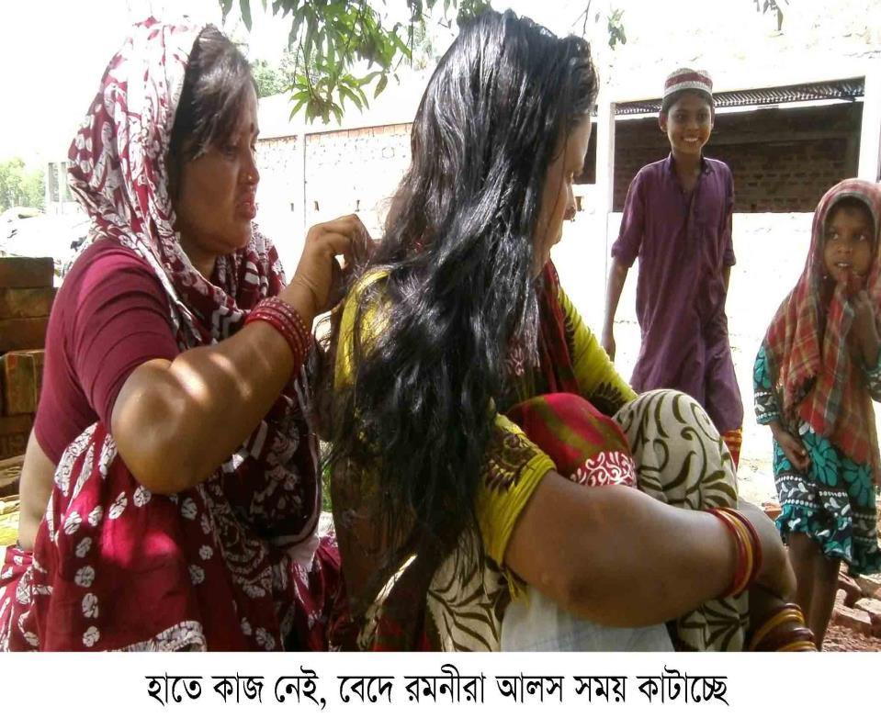
B Read the text and answer the following questions.
River gypsies are an ethnic group in Bangladesh. They are known as bedey to local people. The gypsies have their own lifestyle and culture. They live in groups and do not own any land. Therefore, they live a nomadic life travelling from one place to another. These people roam across our rivers and waters from May to December in small country boats. These boats are their houses and these people are a part of our waters. In winter, many water bodies dry up. At that time they return to the mainland and live in make-shift tarpaulin tents on open river banks. You can see their men relaxing in the tents. play with dogs or other pets in the dust. Women often idle away time by hair doing, lice in twos or threes sitting in a row.
Toddlers
picking off
Notes:
Note: Use of Trigger & Hyperlink shown . Teacher may click on Toddlers & picking off to show their meaning. To be continued he has to click on right arrow.

Slide 19
Hidden Page
Loud reading
Teacher himself may read out this option with proper sound, stress and intonation
Notes:
Not for the students

Slide 20
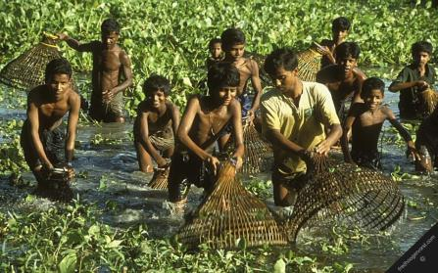
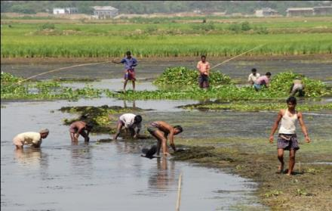
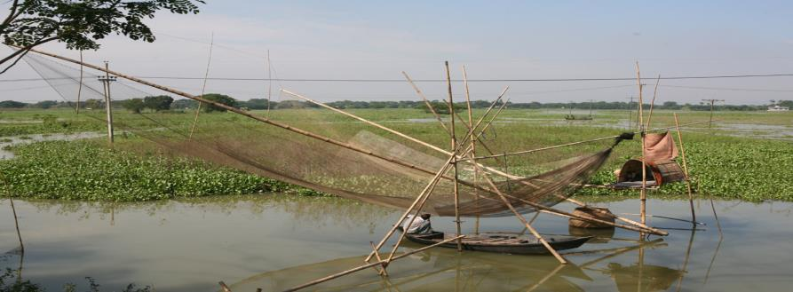
Throughout the monsoon, they remain busy with fishing.
Notes:
Teacher may ask about the pictures and then read out the text to the students and explain.

Slide 21
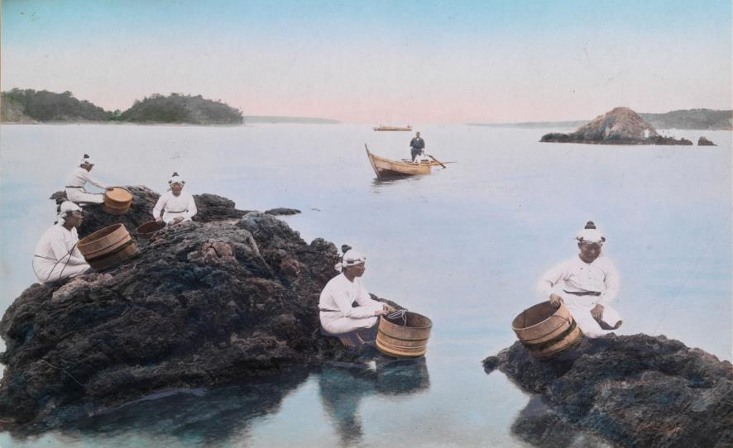
They also dive for natural pearls in waters.
Notes:
Teacher may ask about the pictures and then read out the text to the students and explain.

Slide 22
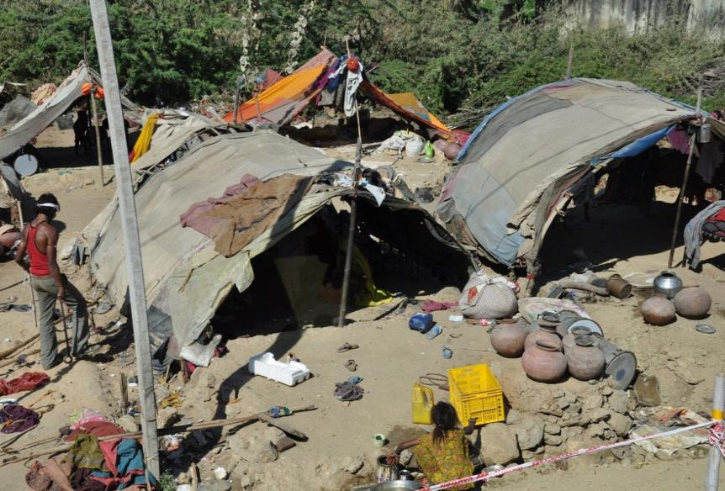
Sometimes, they camp for a couple of weeks.
Notes:
Teacher may ask about the pictures and then read out the text to the students and explain.

Slide 23
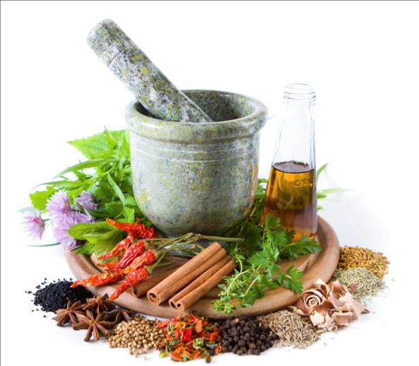
Men catch snakes and entertain people with snake charming and sell herbal cures.
Notes:
Teacher may ask about the pictures and then read out the text to the students and explain.

Slide 24
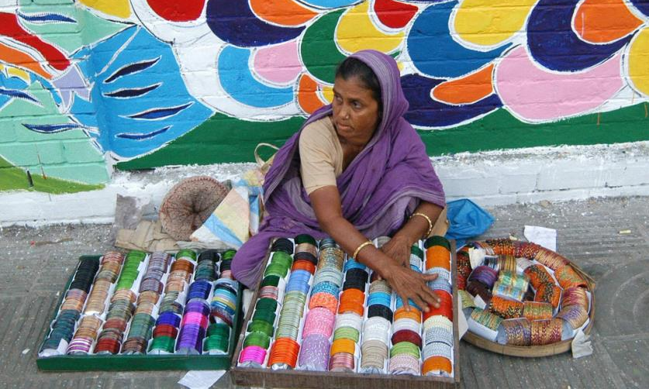
Women go from door to door to sell bangles, cosmetics and other things.
Notes:
Teacher may ask about the pictures and then read out the text to the students and explain.

Slide 25
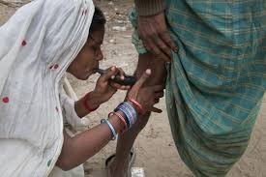
They also try to heal pains of old people often by sucking out blood from their body.
Notes:
Teacher may ask about the pictures and then read out the text to the students and explain.

Slide 26
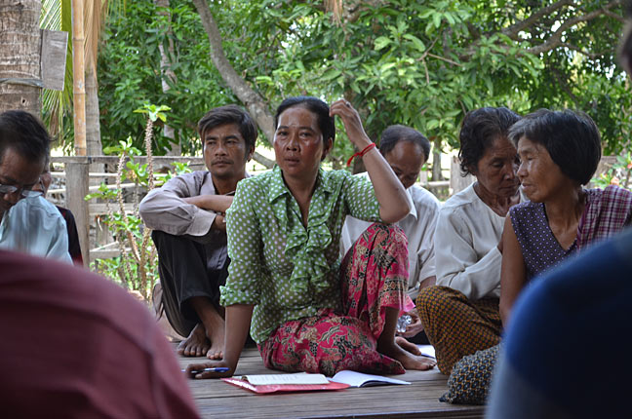
Many villagers believe in the magical power of the gypsies .
Notes:
Teacher may ask about the pictures and then read out the text to the students and explain.

Slide 27
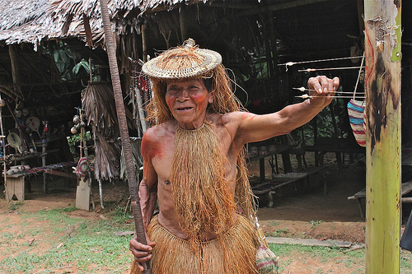
They can make an evil spirit leave someone's body by magic or special Powers.
Notes:
Teacher may ask about the pictures and then read out the text to the students and explain.

Slide 28
Answer the following questions
1 Who are river gypsies?
2 How do they live?
3 What do river gypsies do in winter?
4 What do river gypsy men do for a living?
5 What do river gypsy women do for a living?
Notes:
This option may be conducted orally.

Slide 29
B Discuss with your partner and circle the right answer.
  1 The term ‘ethnic’ is connected with
  a people. b plants.
  c animals. d fishes.
  2 River gypsies roam around on their boats about .......months a year.
  a six b seven
  c eight d nine
  3 River gypsies live in tents in
  a summer. b winter.
  c monsoon. d spring.
  4 The term ‘nomadic’ refers to a person
  a living permanently at a place.
  b travelling from place to place.
  c living in one's own house.
  d living in a rented house.
Notes:
Teacher may ask the answer first then he can show to check.

Slide 30
C Listen to the teacher/CD and fill in the following gaps with right word/s.
U7, L3 C Listening text: 6
1 The river gypsies are among the Nation's ---------------- groups.
2 A 2007 report said --------------- percent live below the poverty line.
3 Only 2 percent of gypsy children are given primary ----.
4 Most gypsy children travel with their parents for an ---- 8 months of the year.
5 So, they end up in a cycle of ----------------------.
Notes:
This option is for listening practice.

Slide 31
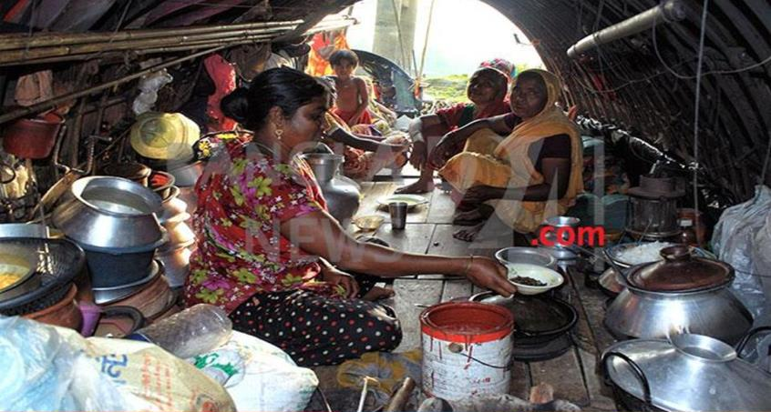
D In summer vacation last May, Sohan went to Lauhajang in Munshigonj to visit his maternal uncle. His elder cousin, Jihan studies sociology at Dhaka University. One afternoon, Jihan took Sohan to a bedey camp to know about their life. They talked to a middle aged bedey woman who was cooking in front of her tent. Read the conversation of the text and do the following activity.
Notes:
Teacher may ask the students to open their book to work section D and E.

Slide 32
E Suppose you were with Sohan. Ask the bedey woman some more questions that you would like to. For example, you can ask questions to know about her family members, their names, age, work, their past living places, future plans, food habit, etc.
Notes:
Teacher may ask the students to open their book to work section D and E.

Slide 33
Home Work
F Have you ever seen any gypsies/bedey/snake charmers or any person selling things from door to door in your area? If not, imagine such a scenery and write your experience about any one of them.
Notes:
Task for the next class.

Slide 34
Allah Hafez

Slide 35
Acknowledgement
We would like to express our cordial gratitude to the Ministry of Education, Directorate of Secondary & Higher Education, NCTB, A2i and the panel of honorable editors ( Md. Jahangir Hasan, Assistant Professor (English) TTC, Rangpur, Ranjit Poddar, Associate Professor (English) TTC, Dhaka, and Urmila Khaled, Assistant Professor (English) TTC, Dhaka, to enrich the contents.

